Slide 1
雅思无忧直播课程-阅读
第一讲
主讲老师：朱峰

Slide 2
第一讲教学计划
1、从网上搜不到的阅读题设计理念
2、短期冲刺所需要的材料评析及答疑
3、填空题的战略方针
4、填空题主干题型的解题方法

Slide 3
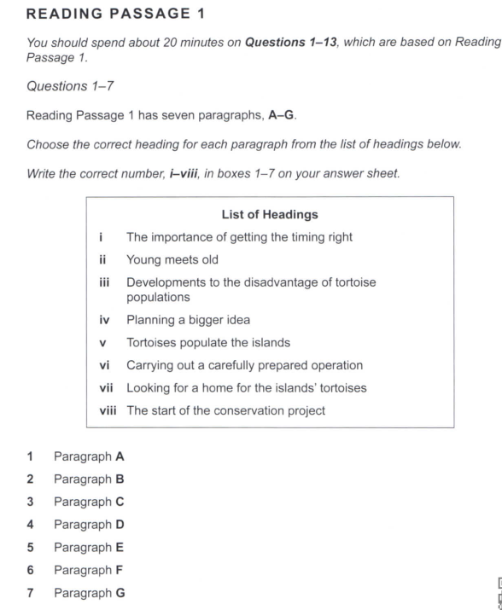
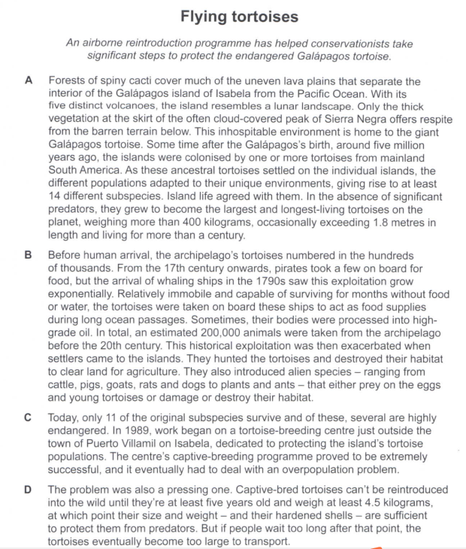
剑12 Test7

Slide 4
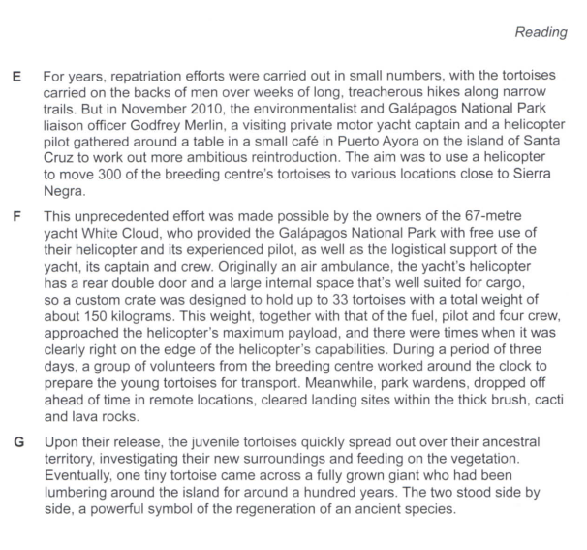
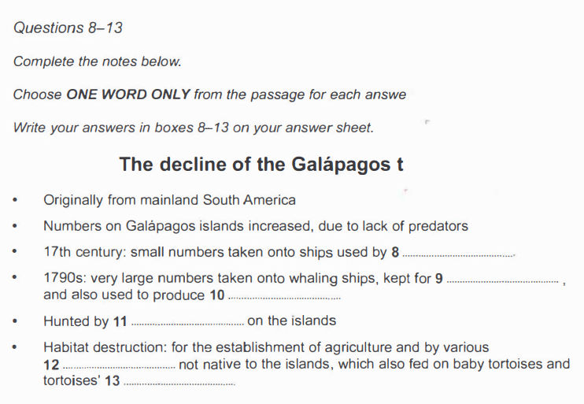

Slide 5
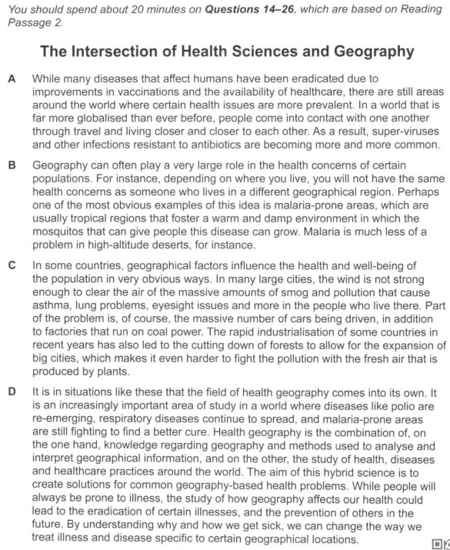
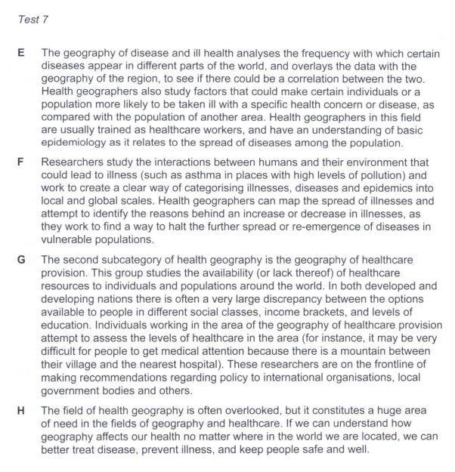

Slide 6
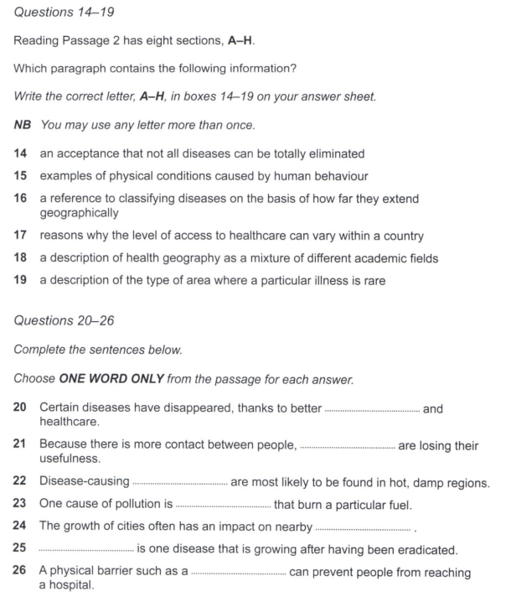

Slide 7
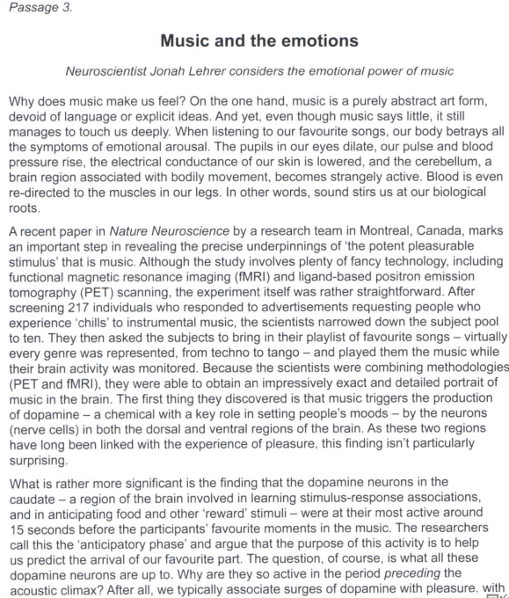
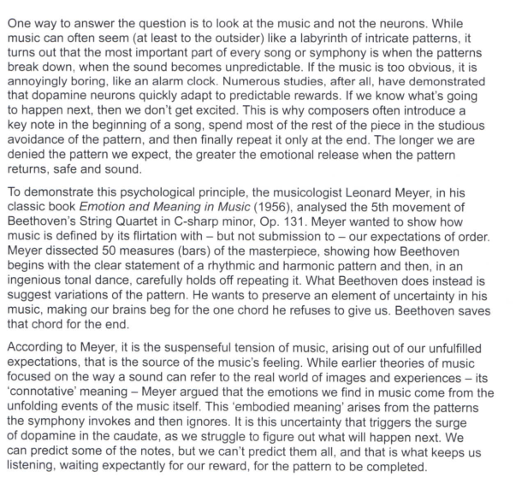

Slide 8
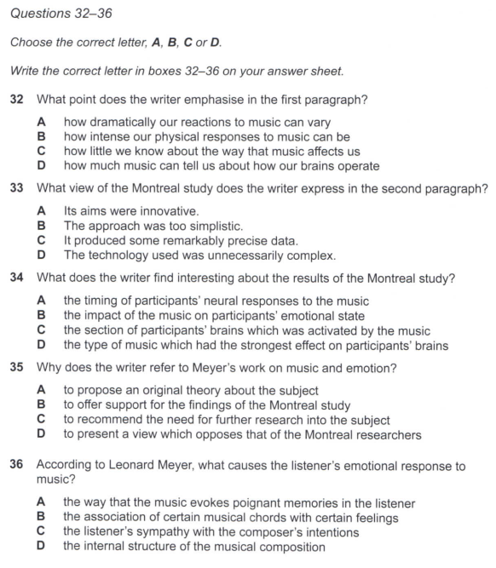
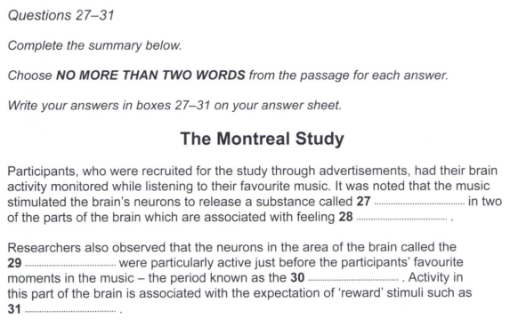

Slide 9
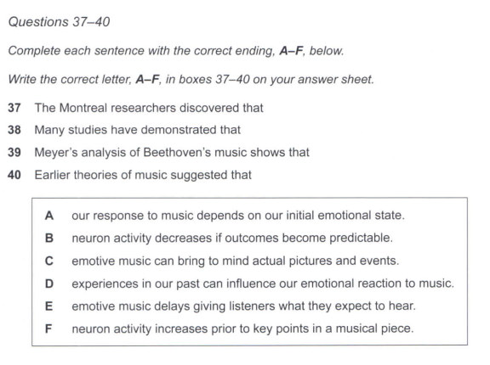

Slide 10
一个我们必须要接受且正视的设定
尽管阅读的三篇文章看起来：
正文都是一千词左右的阅读量
题目数量都是13-14个
每篇都是各种题型混搭
且素材看起来都不是特别友好（自然/社科）
但雅思阅读的三篇文章是存在难度差的

Slide 11
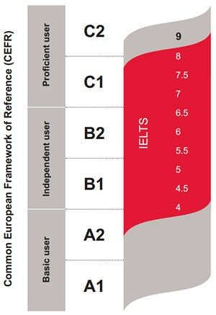
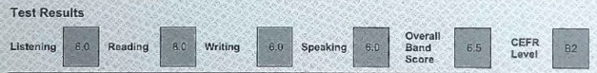
三篇文章的难度对标
P1=B1 中考 4-5分
P2=B2 高考 5.5-6.5分
P3=C1 考研 7-8分
如果想要6.5分，三篇的正确率需要控制在
11/13+9/13+7/14
时间向前两篇倾斜（45:15）

Slide 12
三篇文章的难度对标
P1=B1 中考 4-5分
P2=B2 高考 5.5-6.5分
P3=C1 考研 7-8分
如果想要7.5分，三篇的正确率需要控制在
12/13+11/13+10/14
时间向第三篇倾斜（35:25）

Slide 13
阅读方法有哪些？
以文章为中心的区间平行阅读vs 以题目为中心的定位对应
平行阅读法：
词汇量要求1万以上，且每一句都能做好精准翻译，但看起来“更踏实”
定位对应法：
官方指定的解题方法

Slide 14
为什么建议大家使用定位对应法？
因为定位对应法充分考核了学生的
scan 扫读
skim 泛读
detailed reading 精读
三个阅读能力，以及
paraphrase 近义替换的技巧

Slide 15
一定清楚雅思阅读题型的分类
剑1-17的题型配比
填空 30%
配对 25%
LOH 10%
判断 25%
选择 10%

Slide 16
官方的难度设定
简单：不带选项的填空题（包括简答题） TFNG判断题
中等：match题 information题 LOH题 多选题
困难：带选项的填空题 YNNG判断题 complete题 单选题
而通常三篇文章的题型分布也会以以上设定为指导
此页非常重要，随时拿出来查验核对

Slide 17
剑桥1-4题太老，逐步被市场淘汰 剑桥5-9有与现行难度设定冲突的地方，单刷题型 剑桥10-17非常规范，适合刷套题

Slide 18
词汇量是关键
绝大多数“跟不上老师的速度”“做快了就飘，明明知道答案不对还是去选”
这种情况，都是词汇量不足所导致的
目前建议使用的材料组合为：
核心词汇表（470词）+剑桥词典（没有APP，只有手机网页版和电脑网页版）

Slide 19
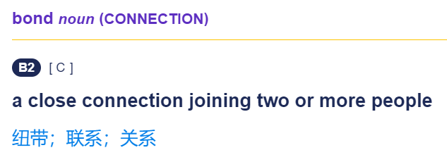
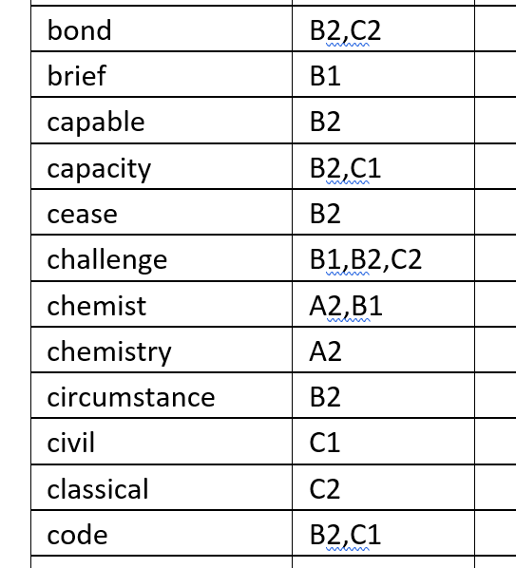
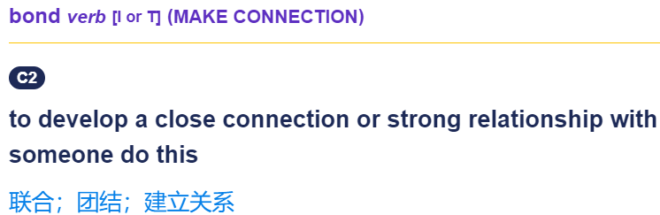
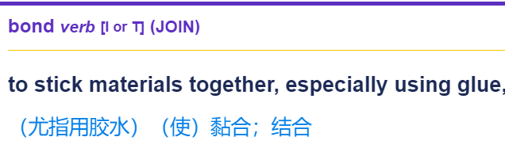

Slide 20
为什么要先做填空题
难度最小
没法蒙
填空题的区间可以指导其他题型的定位

Slide 21
无选项填空题
（段落填空、句子填空、简答、表格、流程、图画）规则：
局部（区间性出题，确定开始结束位置）
顺序（要学会跳题，做不好跟是否按顺序并无关系）
原词（词性不能改，包括单复数也不能改）

Slide 22
解题标准步骤
1、定段
2、定句
3、定词
4、检验

Slide 23
解题标准步骤
1、定段：用尽可能多的名词帮我们定位（数字 符号 大写）
2、定句
3、定词
4、检验

Slide 24
Facial Vision
Blind people report that so-called 'facial vision' is comparable to the sensation of touch on the face. In fact, the sensation is more similar to the way in which pain from a 6………………. arm or leg might be felt. The ability actually comes from perceiving 7……echoes…………. through the ears. However, even before this was understood, the principle had been applied in the design of instruments which calculated the 8………depth………. of the seabed. This was followed by a wartime application in devices for finding 9……submarines…………(C7P20)

Slide 25
D What else might the engineer think of? Well, blind humans sometimes seem to have an uncanny sense of obstacles in their path. It has been given the name 'facial vision', because blind people have reported that it feels a bit like the sense of touch, on the face. One report tells of a totally blind boy who could ride his tricycle at good speed round the block near his home, using facial vision. Experiments showed that, in fact, facial vision is nothing to do with touch or the front of the face, although the sensation may be referred to the front of the face, like the referred pain in a phantom limb. The sensation of facial vision, it turns out, really goes in through the ears. Blind people, without even being aware of the fact, are actually using echoes of their own footsteps and of other sounds, to sense the presence of obstacles. Before this was discovered, engineers had already built instruments to exploit the principle, for example to measure the depth of the sea under a ship. After this technique had been invented, it was only a matter of time before weapons designers adapted it for the detection of submarines. Both sides in the Second World War relied heavily on these devices, under such codenames as Asdic (British) and Sonar (American), as well as Radar (American) or RDF (British), which uses radio echoes rather than sound echoes.

Slide 26
Choose ONE WORD ONLY from the passage for each answer.
Write your answers in boxes 1-3 on your answer sheet.
Some plastics behave in a similar way to 1. __candlewax_______ in that they melt under heat and can be moulded into new forms. Bakelite was unique because it was the first material to be both entirely 2. ___synthetic_____ in origin, and thermosetting.
There were several reasons for the research into plastics in the nineteenth century, among them the great advances that had been made in the field of 3. ___chemistry_____ and the search for alternatives to natural resources like ivory. (C5P40)

Slide 27
Some plastics behave in a similar way to 1. _________ in that they melt under heat and can be moulded into new forms. Bakelite was unique because it was the first material to be both entirely 2. ________ in origin, and thermosetting.
The term 'plastic' comes from the Greek plassein, meaning 'to mould'. Some plastics are derived from natural sources, some are semi-synthetic (the result of chemical action on a natural substance), and some are entirely synthetic, that is, chemically engineered from the constituents of coal or oil. Some are 'thermoplastic', which means that, like candlewax, they melt when heated and can then be reshaped.

Slide 28
Some plastics behave in a similar way to 1. _________ in that they melt under heat and can be moulded into new forms. Bakelite was unique because it was the first material to be both entirely 2. ________ in origin, and thermosetting.
Others are 'thermosetting': like eggs, they cannot revert to their original viscous state, and their shape is thus fixed for ever. Bakelite had the distinction of being the first totally synthetic thermosetting plastic.

Slide 29
The history of today‘s plastics begins with the discovery of a series of semi-synthetic thermoplastic materials in the mid-nineteenth century. The impetus behind the development of these early plastics was generated by a number of factors—immense technological progress in the domain of chemistry, coupled with wider cultural changes, and the pragmatic need to find acceptable substitutes for dwindling supplies of ’luxury‘ materials such as tortoiseshell and ivory
There were several reasons for the research into plastics in the nineteenth century, among them the great advances that had been made in the field of 3. ________ and the search for alternatives to natural resources like ivory.

Slide 30
解题标准步骤
1、定段：用尽可能多的名词帮我们定位（数字 符号 大写）
2、定句：前后句（标杆）+本句（适当放大范围）
3、定词
4、检验

Slide 31
解题标准步骤
1、定段：用尽可能多的名词帮我们定位（数字 符号 大写）
2、定句：前后句（标杆）+本句（适当放大范围）
3、定词：词性（单复数 人地物事）+空前后的近义替换
4、检验

Slide 32
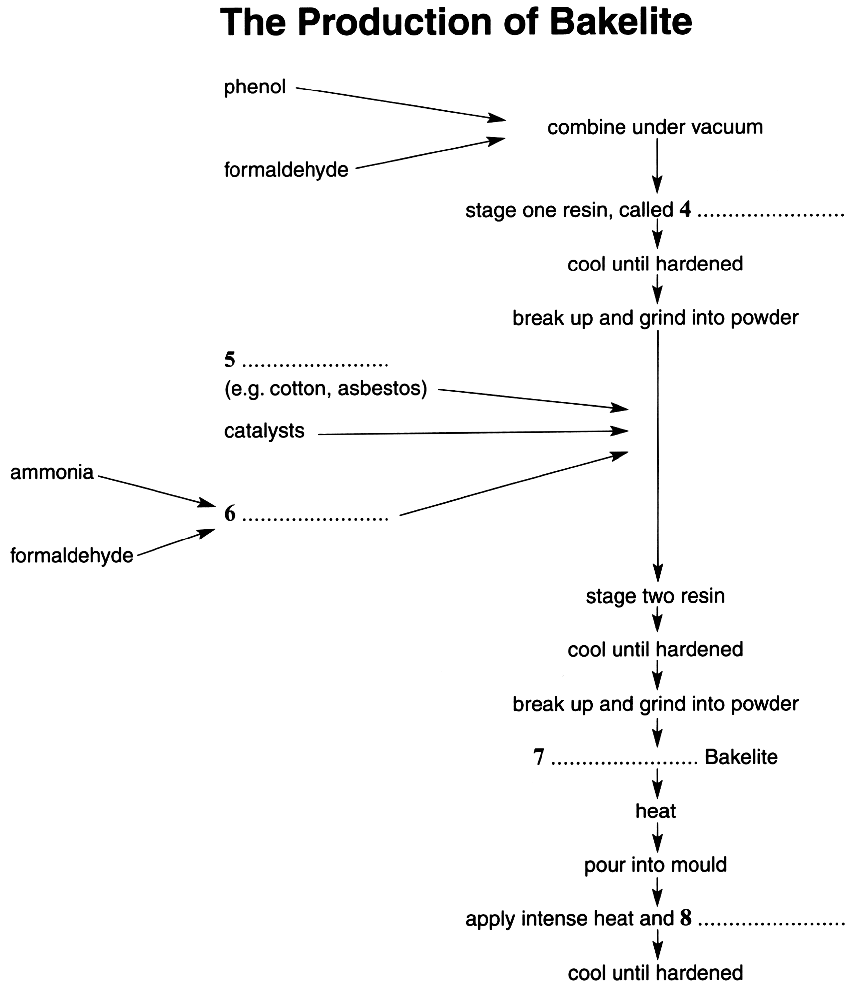

Slide 33
The original patent outlined a three-stage process, in which phenol and formaldehyde (from wood or coal) were initially combined under vacuum inside a large egg-shaped kettle. The result was a resin known as Novalak, which became soluble and malleable when heated. The resin was allowed to cool in shallow trays until it hardened, and then broken up and ground into powder. Other substances were then introduced: including fillers, such as woodflour, asbestos or cotton, which increase strength and moisture resistance, catalysts (substances to speed up the reaction between two chemicals without joining to either) and hexa, a compound of ammonia and formaldehyde which supplied the additional formaldehyde necessary to form a thermosetting resin. This resin was then left to cool and harden, and ground up a second time. The resulting granular powder was raw Bakelite, ready to be made into a vast range of manufactured objects. In the last stage, the heated Bakelite was poured into a hollow mould of the required shape and subjected to extreme heat and pressure, thereby ‘setting’ its form for life.

Slide 34
解题标准步骤
1、定段：用尽可能多的名词帮我们定位（数字 符号 大写）
2、定句：前后句（标杆）+本句（适当放大范围）
3、定词：词性（单复数 人地物事）+空前后的近义替换
4、检验：已经在题干中出现的词不能成为答案
单词数限定（上下限） 名词前的定语一定填

Slide 35
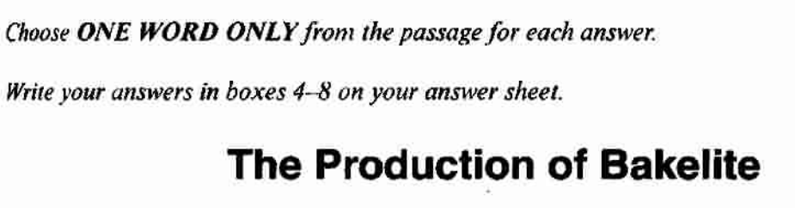
one word only
one word and/or a number
no more than two words

Slide 36
Weather during the Little Ice Age
Documentation of past weather conditions is limited: our main sources of knowledge of conditions in the distant past are 18...........and 19................. we can deduce that the Little Ice Age was a time of 20.............. ,rather than of consistent freezing. Within it there were some periods of very cold winters, other of 21...............and heavy rain, and yet others that saw 22................with no rain at all. （C8P48）
A climatic shifts B ice cores C tree rings
D glaciers E interactions F weather observations
G heat waves H storms I written accounts

Slide 37
Documentation of past weather conditions is limited: our main sources of knowledge of conditions in the distant past are 18...........and 19................. we can deduce that the Little Ice Age was a time of 20.............. ,rather than of consistent freezing. Within it there were some periods of very cold winters, other of 21...............and heavy rain, and yet others that saw 22................with no rain at all.
The Little Ice Age lasted from roughly 1300 until the middle of the nineteenth century. Only two centuries ago, Europe experienced a cycle of bitterly cold winters; mountain glaciers in the Swiss Alps were the lowest in recorded memory, and pack ice surrounded Iceland for much of the year. The climatic events of the Little Ice Age did more than help shape the modern world. They are the deeply important context for the current unprecedented global warming. The Little Ice Age was far from a deep freeze, however; rather an irregular seesaw of rapid climatic shifts, few lasting more than a quarter-century, driven by complex and still little understood interactions between the atmosphere and the ocean. The seesaw brought cycles of intensely cold winters and easterly winds, then switched abruptly to years of heavy spring and early summer rains, mild winters, and frequent Atlantic storms, or to periods of droughts, light northeasterly winds, and summer heat waves.

Slide 38
Documentation of past weather conditions is limited: our main sources of knowledge of conditions in the distant past are 18...........and 19................. we can deduce that the Little Ice Age was a time of 20.............. ,rather than of consistent freezing. Within it there were some periods of very cold winters, other of 21...............and heavy rain, and yet others that saw 22................with no rain at all.
Reconstructing the climate changes of the past is extremely difficult, because systematic weather observations began only a few centuries ago, in Europe and North America. Records from India and tropical Africa are even more recent. For the time before records began, we have only 'proxy records' reconstructed largely from tree rings and ice cores, supplemented by a few incomplete written accounts. We now have hundreds of tree-ring records from throughout the northern hemisphere, and many from south of the equator, too, amplified with a growing body of temperature data from ice cores drilled in Antarctica, Greenland, the Peruvian Andes, and other locations, we are close to a knowledge of annual summer and winter temperature variations over much of the northern hemisphere going back 600 years.

Slide 39
带选项的填空题
1 定段 题干+选项
2 定句 句子之间可能乱序
3 定词 答案可能是选项原词 也可能做近义替换

Slide 40
作业
任何一本剑桥真题集的P8，还有做完讲义第一篇剩下三个空
剑6T4P3 P97 Q35-39（段落填空）
剑7T3P1 P68 Q7-13 （带选项的填空）

